Slide 1
JavaScript Promises
Pulak (@pulakb)
http://pulakonline.com/

Slide 2
Discussions
Callbacks
JavaScript Promises
jQuery
‘q’ library
AngularJs
Node.js

Slide 3
What is a Callback function?
How Callback function work?
‘Callback hell’

Slide 4
What is a Callback function?
A callback function (say, Y) is a function that is passed to another function (say, X) as a parameter, and Y gets executed inside X.
JavaScript uses callback functions to handle asynchronous control flow.
1 2 3 | $( "#dataRow" ).on( "click", function() { alert(‘hello’); });

Slide 5
How Callback function work?
function writeCode(callback) { //do something
callback();
//…..
}
function introduceBugs() {
//…. Make bugs
}
writeCode(introduceBugs)

Slide 6
How Callback function work?
fs = require('fs');
fs.readFile ('f1.txt','utf8',function(err,data) {
if (err) {
return console.log(err);
}
console.log(data);
});

Slide 7
How Callback function work?
fs = require('fs');
fs.readFile('f1.txt','utf8',function(err,data){
if (err) {
return console.log(err);
}
console.log(data);
});

Slide 8
How Callback function work?
fs = require('fs');
fs.readFile('f1.txt','utf8',
function(err,data){
if (err) {
return console.log(err);
}
console.log(data);
}
);
Equivalent
formatting

Slide 9
‘Callback hell’
Code complexity
Modularity
Maintainability
Tightly coupled interface

Slide 10
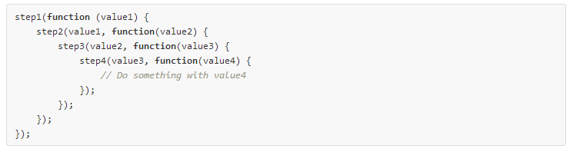
‘Callback hell’
When working with callbacks, nesting of functions can make reading and understanding the code very difficult

Slide 11
Promises
What is Promise?
What is Deferred?
Deferred & Promise
What are the use cases of Promise?
What does Promises guarantee?
Why promises are awesome?

Slide 12
What is Promise?
A promise is an object that represents the return value or the thrown exception that the function may eventually provide.
In other words, a promise represents a value that is not yet known. A promise is an asynchronous value.
The core idea behind promises is that a promise represents the result of an asynchronous operation.
A Promise has 3 possible states
Pending
Fulfilled
Rejected

Slide 13
Deferred & Promise
A deferred (object) represents a work that is not yet finished.
A promise (property) is a placeholder for a result which is initially unknown.
Every deferred has a promise which functions as a proxy for the future result.
From a semantic perspective this means that instead of calling a function ( callback ), we are able to return a value ( promise ).

Slide 14
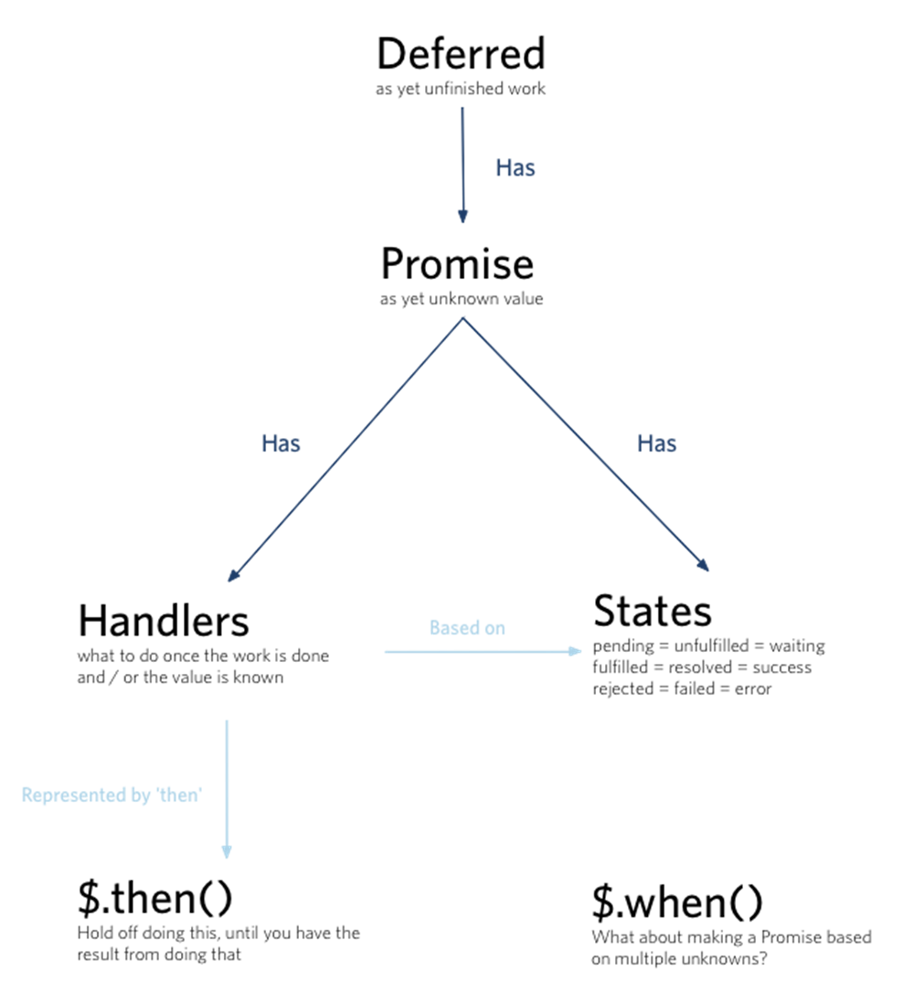

Slide 15
What are the use cases of Promise?
An AJAX request and callbacks(a single request, parallel/chained requests)
An asynchronous loading of assets and actions to perform
Animation
Modal User Interaction

Slide 16
What does Promise guarantee?
promiseForResult.then(onFulfilled, onRejected);
Only one of onFulfilled or onRejected will be called.
onFulfilled will be called with a single fulfillment value (⇔ return value).
onRejected will be called with a single rejection reason (⇔ thrown exception).
If the promise is already settled, the handlers will still be called once you attach them.
The handlers will always be called asynchronously.

Slide 17
What does Promise guarantee?
At ﬁrst, a Promise is in a pending state. Eventually, it’s either resolved or rejected.
Once a Promise is resolved or rejected, it’ll remain in that state forever, and its callbacks will never ﬁre again
Promises can be chained

Slide 18
Why promises are awesome
Cleaner method signatures
Uniform return/error semantics
Easy composition
Easy sequential/parallel join
Always async
Exception-style error bubbling

Slide 19
Case 1: Simple Functional Transform
var author = getAuthors(); var authorName = author.name; // becomes var authorPromise = getAuthors().then(function (author) { return author.name; });

Slide 20
Case 2: Reacting with an Exception
var author = getAuthors(); if (author === null) throw new Error("null author!"); becomes var authorPromise = getAuthors().then(function (author) { if (author === null) throw new Error("null author!"); return author; });

Slide 21
Case 3: Handling an Exception
try { updateAuthor(data); } catch (ex) { console.log("There was an error:", ex); } // becomes var updatePromise = updateAuthor(data).then(undefined, function (ex) { console.log("There was an error:", ex); });

Slide 22
Case 4: Rethrowing an Exception
try { updateAuthor(data); } catch (ex) { throw new Error("Updating author failed. Details: " + ex.message); } // becomes var updatePromise = updateAuthor(data).then(undefined, function (ex) { throw new Error("Updating author failed. Details: " + ex.message); });

Slide 23
Async Case: Waiting
var name = promptForNewAuthorName(); updateAuthor({ name: name }); refreshScreen(); // becomes promptForNewAuthorName() .then(function (name) { return updateAuthor({ name: name }); }) .then(refreshScreen);

Slide 24
jQuery

Slide 25

Q - library

Slide 26
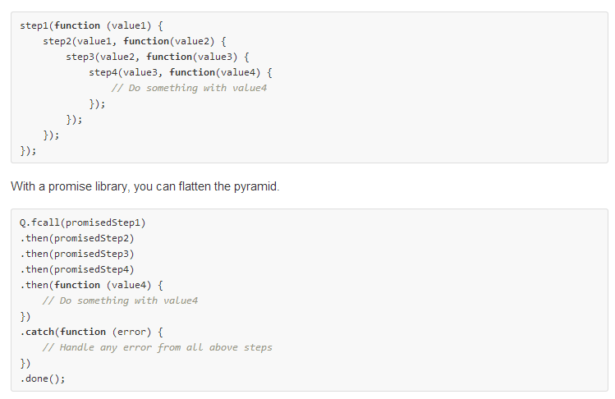
Q - library

Slide 27
jQuery - q differences
jQuery | Q | Notes
then | then | Q's then, and in fact all of its methods, have different exception-handling behavior, as described above.
done | then | then does not support multiple handlers; use multiple calls to then to attach them.
fail | catch | catch does not support multiple handlers; use multiple calls to catch to attach them.
deferred.promise(method) | deferred.promise(property) | You *must* get the promise part of the deferred; the deferred does not have the promise API.
https://github.com/kriskowal/q/wiki/Coming-from-jQuery

Slide 28
Node and q library

Slide 29
AngularJS

Slide 30
AngularJS
Limitations of Promise in Angular
In Angular's $Q implementation, If you don't fire off $scope.$apply(), after resolving, the resolved values will never propagate to your 'then' functions. Sometimes I want to use promises that aren't tied to my Angular $digest cycle.﻿

Slide 31
URLs
Credit goes to all the people for sharing their thoughts:
http://wiki.commonjs.org/wiki/Promises/A
http://promisesaplus.com/
http://promisesaplus.com/differences-from-promises-a
http://api.jquery.com/category/deferred-object/
http://sitr.us/2012/07/31/promise-pipelines-in-javascript.html
http://stackoverflow.com/questions/12160785/jquery-deferred-promise-design-patterns-and-use-cases
http://stackoverflow.com/questions/6801283/what-are-the-differences-between-deferred-promise-and-future-in-javascript
http://stackoverflow.com/questions/5436327/jquery-deferreds-and-promises-then-vs-done
http://blog.mediumequalsmessage.com/promise-deferred-objects-in-javascript-pt1-theory-and-semantics
https://gist.github.com/domenic/3889970
http://domenic.me/2012/10/14/youre-missing-the-point-of-promises/
https://github.com/kriskowal/q
https://github.com/kriskowal/uncommonjs/blob/master/promises/specification.md
http://james.padolsey.com/jquery/#v=2.0.3&fn=jQuery.Deferred
http://www.dwmkerr.com/promises-in-angularjs-the-definitive-guide/
http://spion.github.io/posts/why-i-am-switching-to-promises.html
http://blog.ometer.com/2011/07/24/callbacks-synchronous-and-asynchronous/

Slide 32
Q &A

